Slide 1
Time Series: Autoregressive models ARIMA-Part2
1 / 77

Slide 2
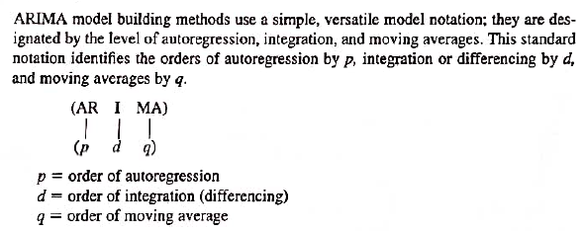
ARIMA Notation – p,d,q

Slide 3
ARIMA
It is a linear regression model that uses its own lags as predictors.
Linear regression models, as you know, work best when the predictors are not correlated and are independent of each other.
Make a series stationary (difference) -subtract the previous value from the current value. Sometimes, depending on the complexity of the series, more than one differencing may be needed.
The value of d, therefore, is the minimum number of differencing needed to make the series stationary. And if the time series is already stationary, then d = 0.

Slide 4
AR
Pure Auto Regressive (AR only) model is one where Yt depends only on its own lags. That is, Yt is a function of the ‘lags of Yt’.

Slide 5
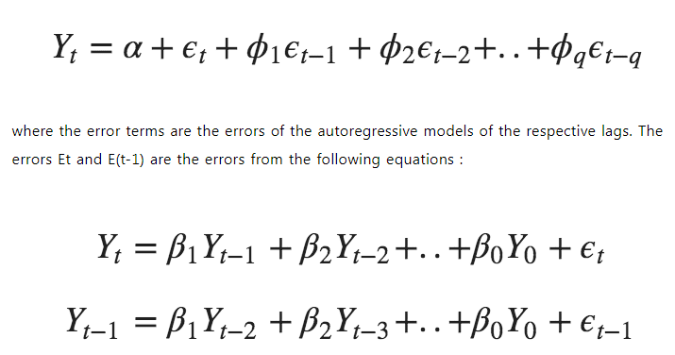
MA
A pure Moving Average (MA only) model is one where Yt depends only on the lagged forecast errors

Slide 6
ARIMA
.
Predicted Y_{t} =
Constant +
Linear combination Lags of Y (up to p lags) + Linear Combination of Lagged forecast errors (up to q lags)
An ARIMA model is one where the time series is differenced at least once to make it stationary and you combine the AR and the MA terms

Slide 7
ARIMA
.
An ARIMA model is one where the time series is differenced at least once to make it stationary and you combine the AR and the MA terms

Slide 8
Recap
ARIMA(1,0,0)
ARIMA(0,0,1)

Slide 9
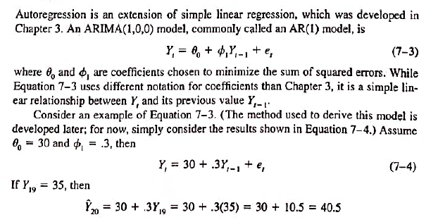
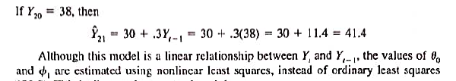
ARIMA Notation – p,d,q

Slide 10
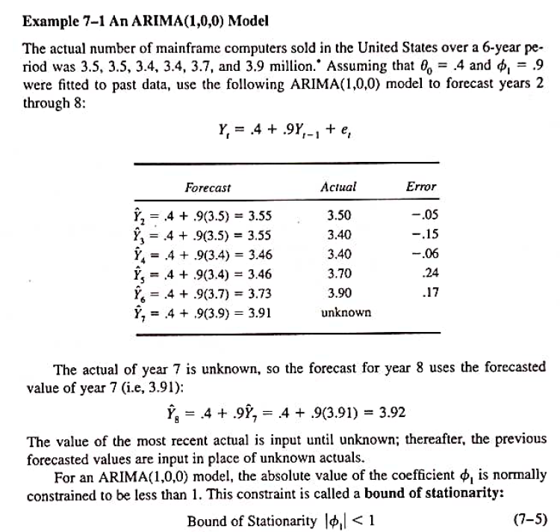

Slide 11
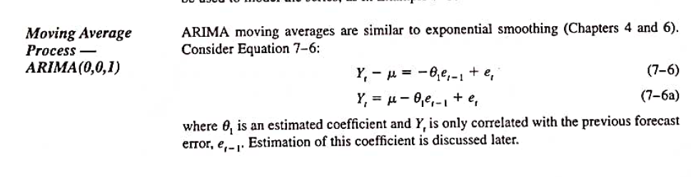
ARIMA (0,0,1)

Slide 12
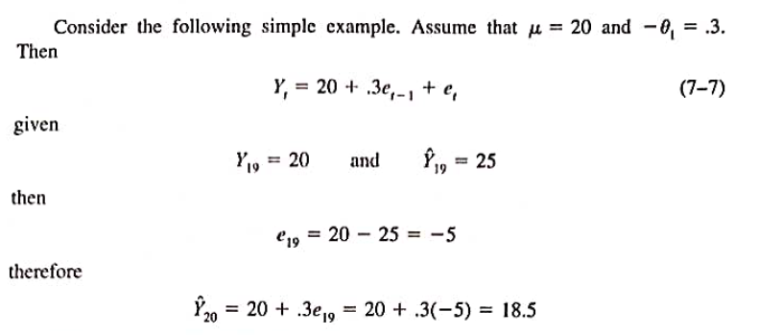
ARIMA (0,0,1)

Slide 13
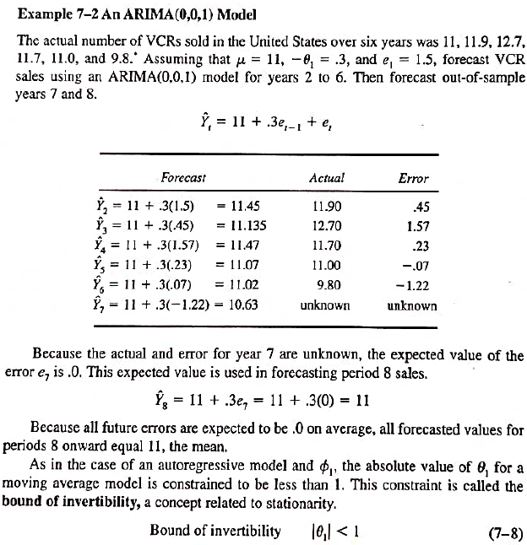

Slide 14
Integrated Processes ARIMA(0,1,0)

Slide 15
Deterministic Trend and Drift
The patterns in TS are result of fundamental processes.
Integrated Series are basically summed Series

Slide 16
Deterministic Trend and Drift
Integrated processes are level non-stationary series (since their means are not constant). Eg:
Trends and
Random Walks
The means either randomly change as the series randomly walks or consistently increase(or decrease).

Slide 17
Deterministic Trend and Drift
A deterministic trend: is a systematic period-to-period increase or decrease that persist for many time periods.
(Because trends represent long-run general movements in a time series, they are important to model).
Stochastic Trend – Random walk behavior
The patterns in TS are result of fundamental processes.

Slide 18
Integrated Series- ARIMA(0,1,0)
Integrated Series (summed series) include Random Walks and Trends.

Slide 19
ARIMA(0,1,0)
Random Walk Model
If a series is random in nature, then the previous actual value is the best predictor.

Slide 20
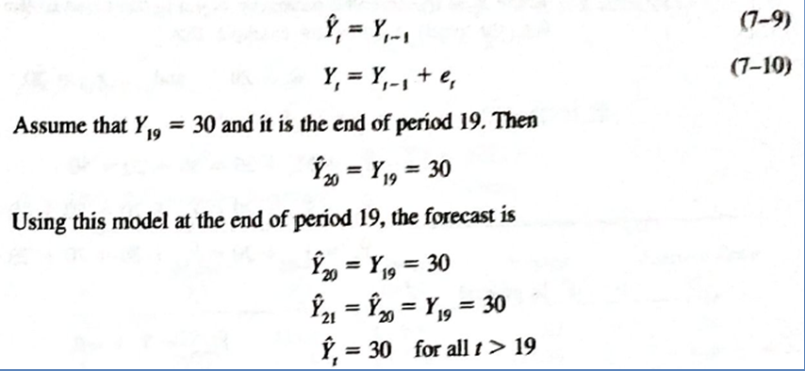
ARIMA(0,1,0) Random Walk Model
If a series is a Random Walk, then the previous actual value is a best predictor for all future values

Slide 21
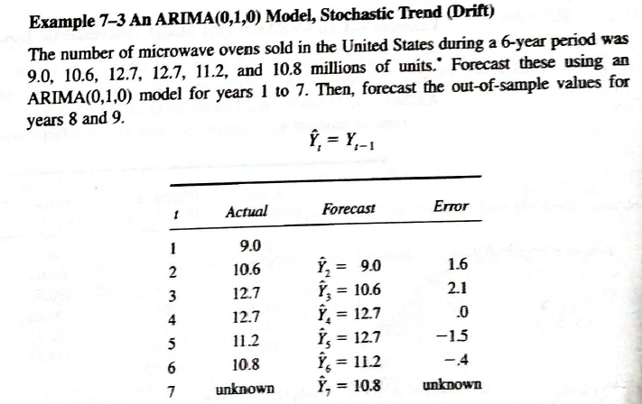

Because the actual for year 7 is not known, its forecasted value is
used in predicting Year 8 sales.
In fact all forecasts for year 8 onwards equal 10.8

Slide 22
Thank You
22 / 77

